Slide 1


Injected and Leaked:
Actively Inducing Side-Channel Leakage Using
Electromagnetic Injection and Hardware Nonlinearity
Haoran Yan¹, Ziyu Shao¹, Shuhao Zhang¹,
Qinhong Jiang², Yan Long¹
1
2

Slide 2
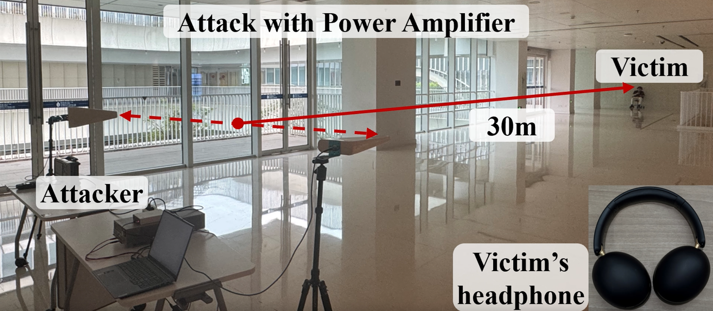

Case 1: 30 m Long Range Audio Eavesdropping
Long-distance audio eavesdropping setup
Scan the QR code to
hear the eavesdropped audio!
Haoran Yan | hyan097@connect.hkust-gz.edu.cn
Injected and Leaked: Actively Inducing Side-Channel Leakage Using Electromagnetic Injection and Hardware Nonlinearity | https://injecteave.github.io/

Slide 3
EM Side Channel Leakage
Passive EM Side Channel
MagEar [Liao et al., 2022]
< 60 cm
Periscope [Chen et al., 2024]
< 1.05 m
Inefficient EM radiation and
low-SNR passive leakage
Injected and Leaked: Actively Inducing Side-Channel Leakage Using Electromagnetic Injection and Hardware Nonlinearity | https://injecteave.github.io/

Slide 4
EM Side Channel Leakage
Passive EM Side Channel
Active EM Side Channel
MagEar [Liao et al., 2022]
Our work InjectEave
< 60 cm
> 30 m
Periscope [Chen et al., 2024]
< 1.05 m
Inefficient EM radiation and
low-SNR passive leakage
Actively amplifies and controls
weak leakage
Injected and Leaked | https://injecteave.github.io/

Slide 5
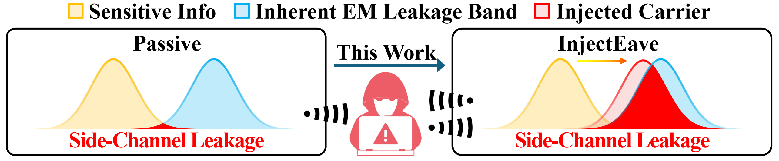
Key Idea: Active EM Side-channel Eavesdropping
Injected EM carriers can piggyback secret signals, overcoming the mismatch between target signal frequencies and efficient EM emissions.
Haoran Yan | hyan097@connect.hkust-gz.edu.cn
Injected and Leaked: Actively Inducing Side-Channel Leakage Using Electromagnetic Injection and Hardware Nonlinearity | https://injecteave.github.io/

Slide 6
Key Idea: Active EM Side-channel Eavesdropping
Injected EM carriers can piggyback secret signals, overcoming the mismatch between target signal frequencies and efficient EM emissions.
No software/hardware modification
Inherent hardware nonlinearity (not wireless flaws)
External physical eavesdropper
Haoran Yan | hyan097@connect.hkust-gz.edu.cn
Injected and Leaked: Actively Inducing Side-Channel Leakage Using Electromagnetic Injection and Hardware Nonlinearity | https://injecteave.github.io/

Slide 7
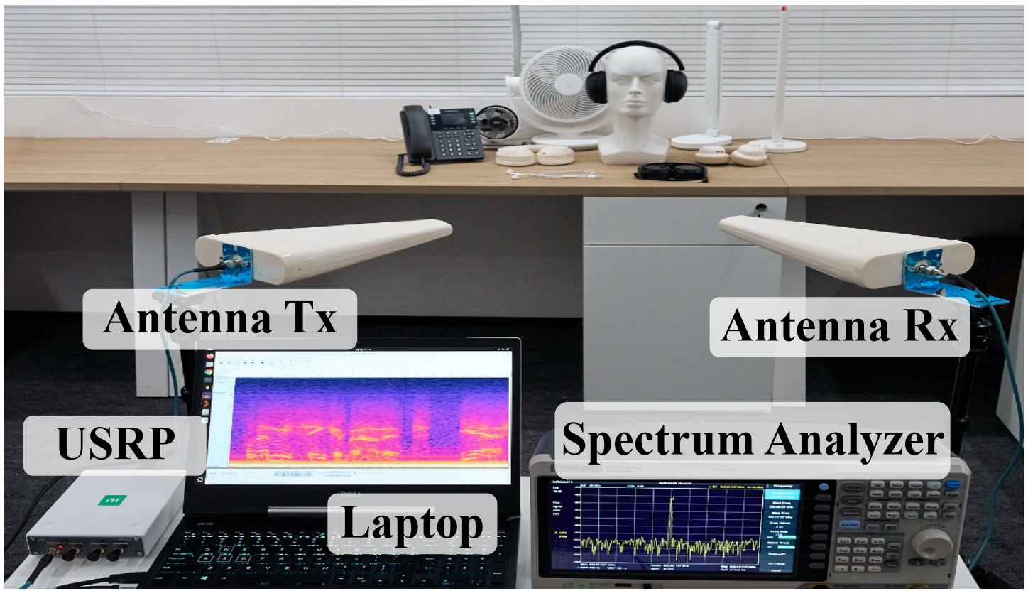
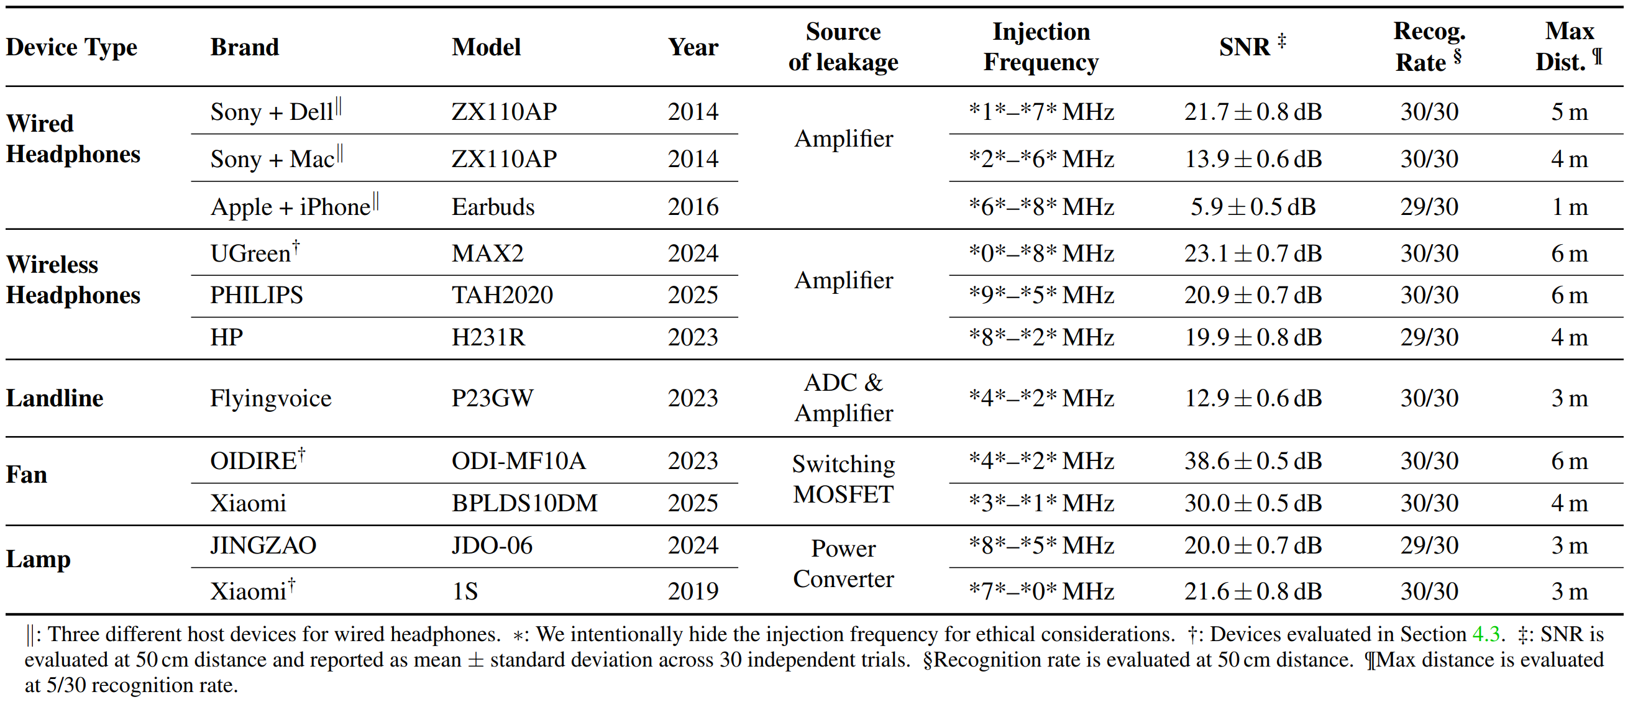
Works Across Everyday Devices
Tested Devices
5 types, 11 devices
The hardware setup for evaluating COTS devices.
Summary of Attacks on COTS Devices.
Haoran Yan | hyan097@connect.hkust-gz.edu.cn
Injected and Leaked: Actively Inducing Side-Channel Leakage Using Electromagnetic Injection and Hardware Nonlinearity | https://injecteave.github.io/

Slide 8
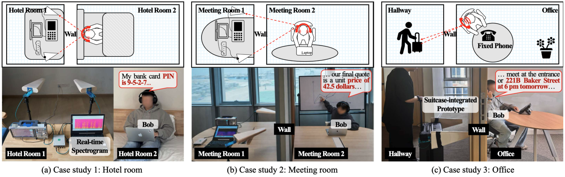
Case 2: Through Wall Audio Eavesdropping
Case studies of representative through wall audio eavesdropping scenarios.
Injected and Leaked: Actively Inducing Side-Channel Leakage Using Electromagnetic Injection and Hardware Nonlinearity | https://injecteave.github.io/

Slide 9
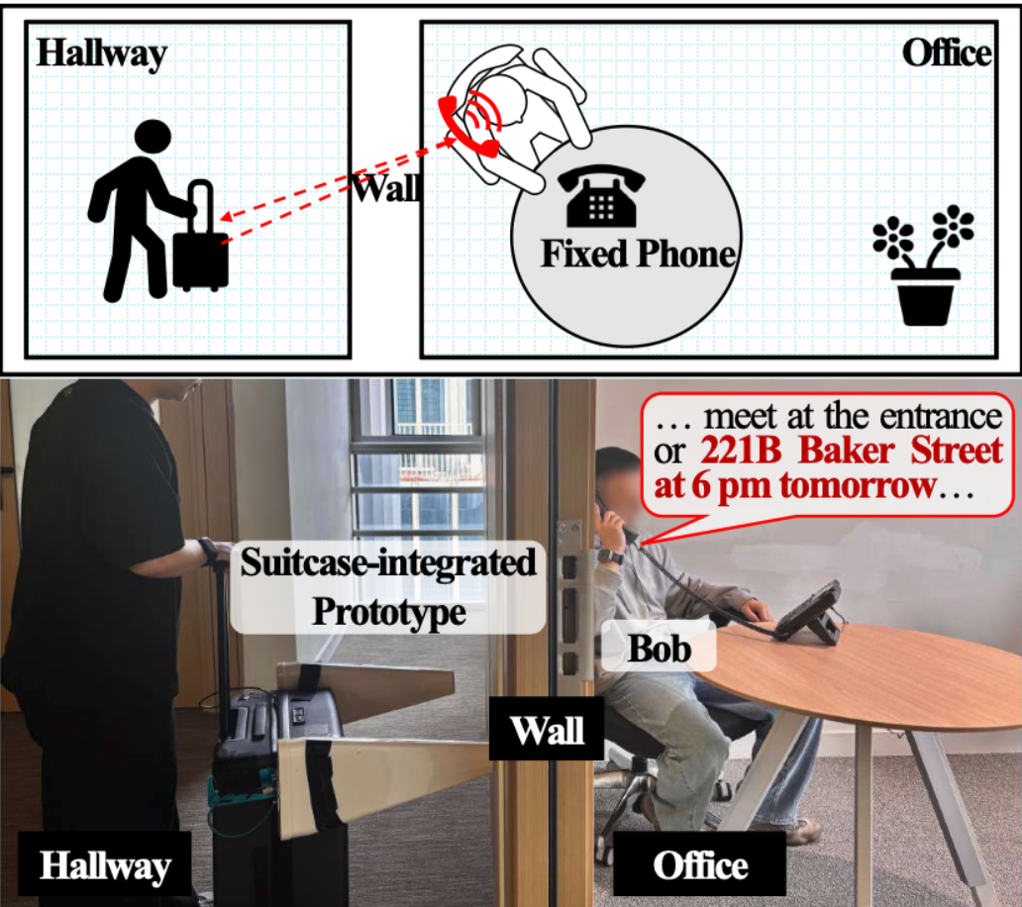
Case 3: Landline Closed-loop Manipulation
1: Eavesdrop
2: Synthesize
3: Inject
Eavesdropped: " Yes, I agree. "
→Synthesized: " Actually, I disagree. "
→injected: " Actually, I disagree. "
Haoran Yan | hyan097@connect.hkust-gz.edu.cn
Injected and Leaked: Actively Inducing Side-Channel Leakage Using Electromagnetic Injection and Hardware Nonlinearity | https://injecteave.github.io/

Slide 10

Better RF Hardware Pushes the Range Further
$$d_{max}∝\sqrt{\frac{\left|V_{inj}\right|⋅\left|V_{sec}\right|}{N_{sys}}}$$
$$d_{max}$$
: Maximum Eavesdropping Range
: Injection Strength
: Secret-Signal Strength
: System Noise Floor
$$\left|V_{inj}\right|$$
$$\left|V_{sec}\right|$$
$$N_{sys}$$
Haoran Yan | hyan097@connect.hkust-gz.edu.cn
Injected and Leaked: Actively Inducing Side-Channel Leakage Using Electromagnetic Injection and Hardware Nonlinearity | https://injecteave.github.io/
Notes:
未来进一步提高

Slide 11
Better RF Hardware Pushes the Range Further
$$d_{max}∝\sqrt{\frac{\left|V_{inj}\right|⋅\left|V_{sec}\right|}{N_{sys}}}$$
$$d_{max}$$
: Maximum Eavesdropping Range
: Injection Strength
: Secret-Signal Strength
: System Noise Floor
$$\left|V_{inj}\right|$$
$$\left|V_{sec}\right|$$
$$N_{sys}$$
$$N_{sys}$$
Higher power and antenna gain
$$\left|V_{inj}\right|$$
Lower phase noise and receiver noise
Haoran Yan | hyan097@connect.hkust-gz.edu.cn
Injected and Leaked: Actively Inducing Side-Channel Leakage Using Electromagnetic Injection and Hardware Nonlinearity | https://injecteave.github.io/
Notes:
未来进一步提高

Slide 12




Broad Threat : Nonlinearity Is Everywhere
Nonlinearity enables essential hardware functions and is
unavoidable in real-world systems.
Real-world computing systems
Haoran Yan | hyan097@connect.hkust-gz.edu.cn
Injected and Leaked: Actively Inducing Side-Channel Leakage Using Electromagnetic Injection and Hardware Nonlinearity | https://injecteave.github.io/

Slide 13





Summary
Active injection turns weak leakage into controllable leakage.
Hardware designs and EM shielding of existing systems.
can/should be improved.
Watch out for suspicious antennas if you are wearing headphones.
Team
https://injecteave.github.io/
Haoran Yan
Ziyu Shao
Shuhao Zhang
Qinhong Jiang
Yan Long
Haoran Yan | hyan097@connect.hkust-gz.edu.cn
Injected and Leaked: Actively Inducing Side-Channel Leakage Using Electromagnetic Injection and Hardware Nonlinearity | https://injecteave.github.io/

